Slide 1
The future through the eyes of progressive youth
Center for modeling the future
HORIZON 2100

Slide 2
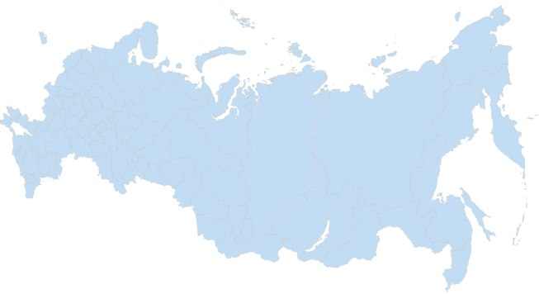
Daria Mincheva Russia
Regis Ruzani Zimbabwe
Rachel Lloyd USA
Melissa Moscoso
Ecuador
Stanislav Plotnikov
Russia
Eddie Mejia Guatemala

Slide 3
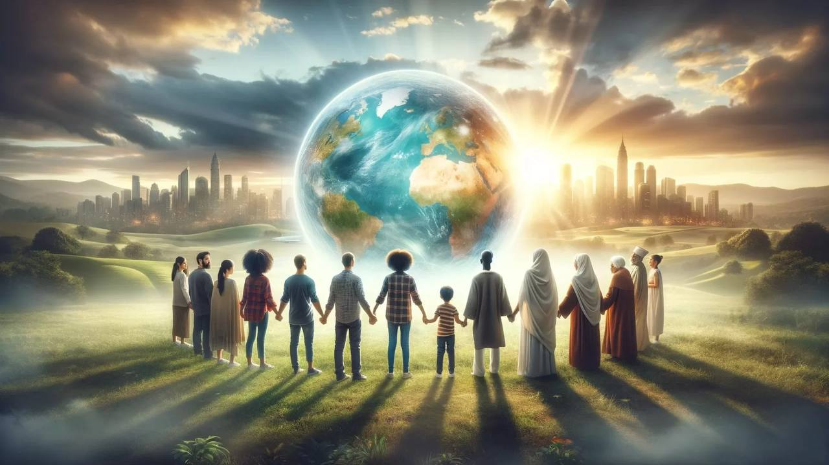
We will not allow our world to continue on its current path of destruction.
We will make positive changes by emphasizing humanity more meaningfully.
We will take responsibility for our world in a way that no one has taken it before.

Slide 4
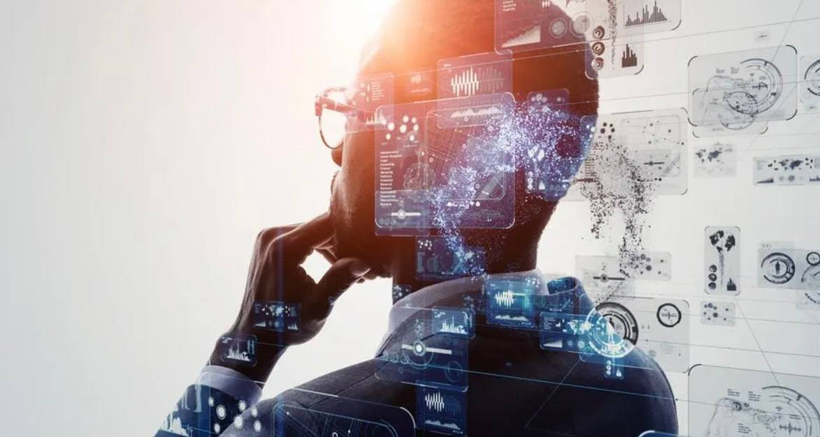
Considering the future of the global and Russian economy, we seeit as a concept of high innovative impact. Technology will play an important role in shaping the new global economic model.

Slide 5
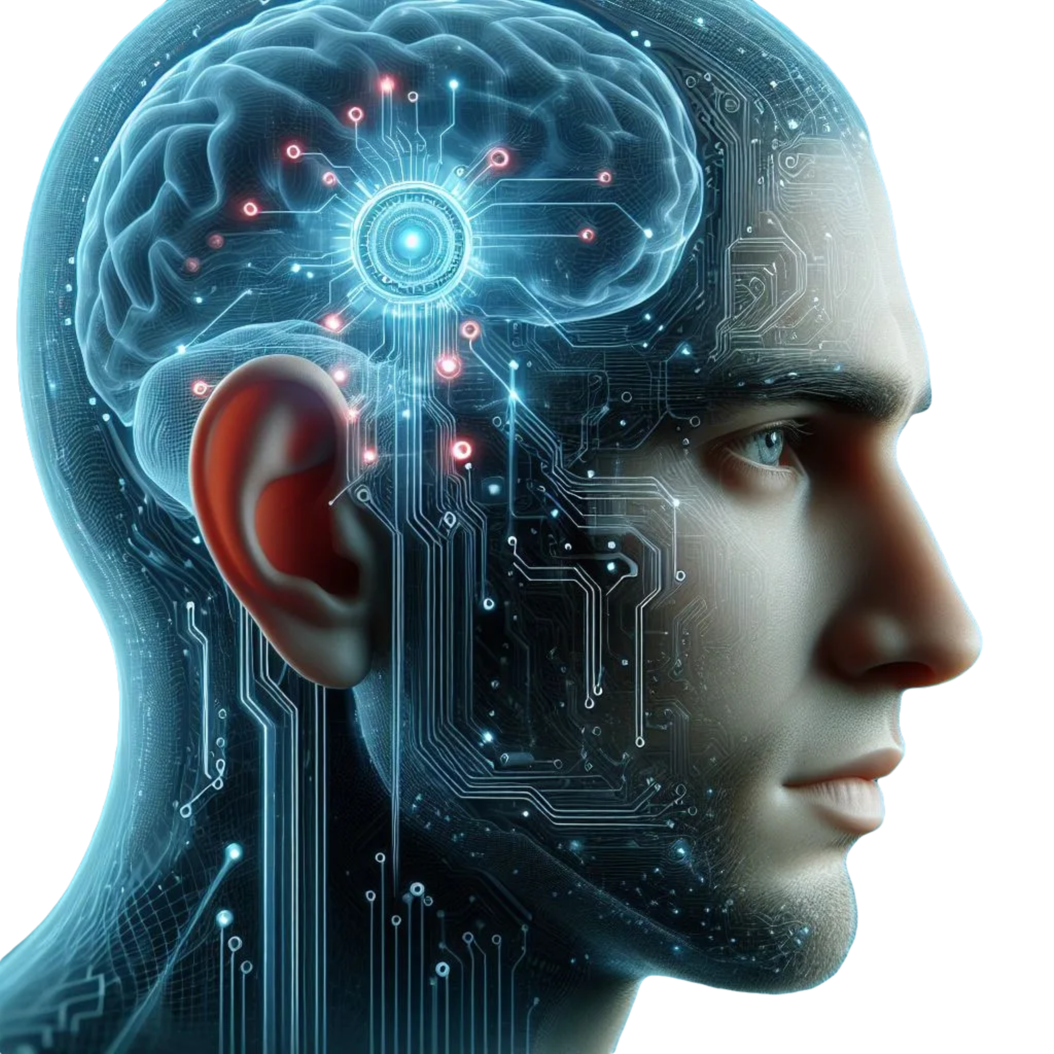
Human of the future
Health and well-being
Effective communication
Management and control
Economic efficiency

Slide 6
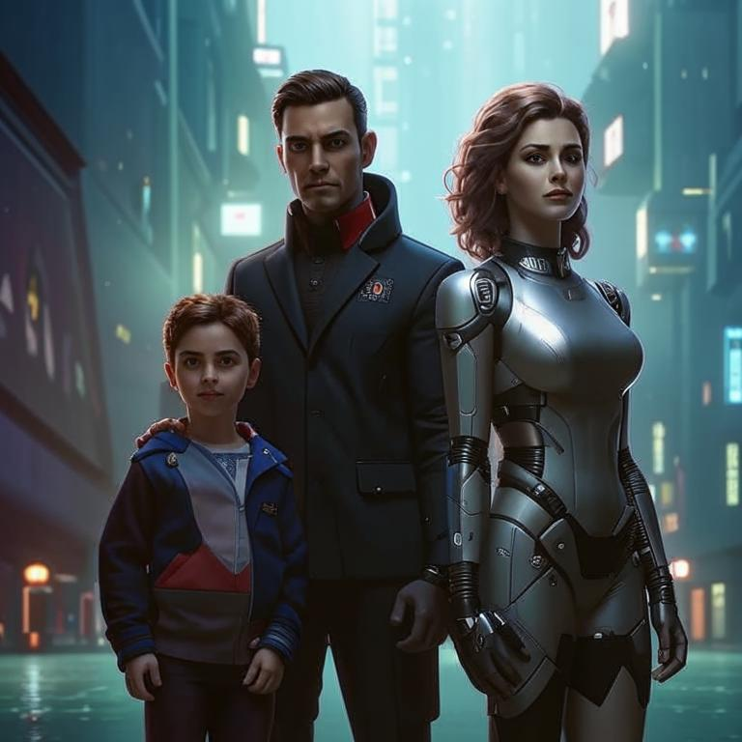
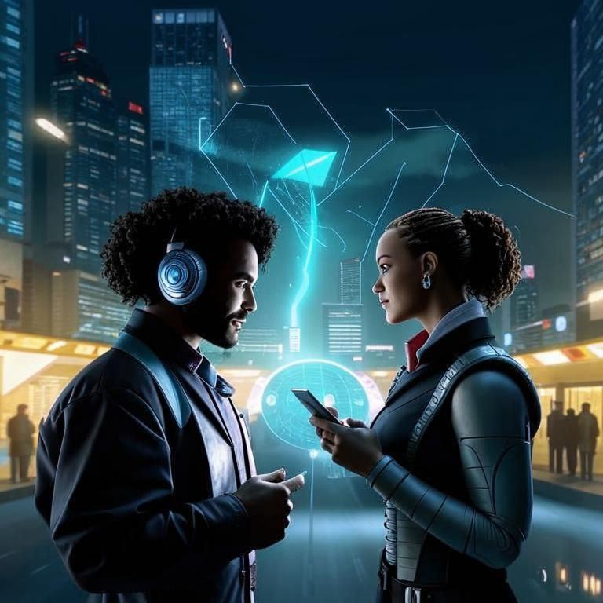
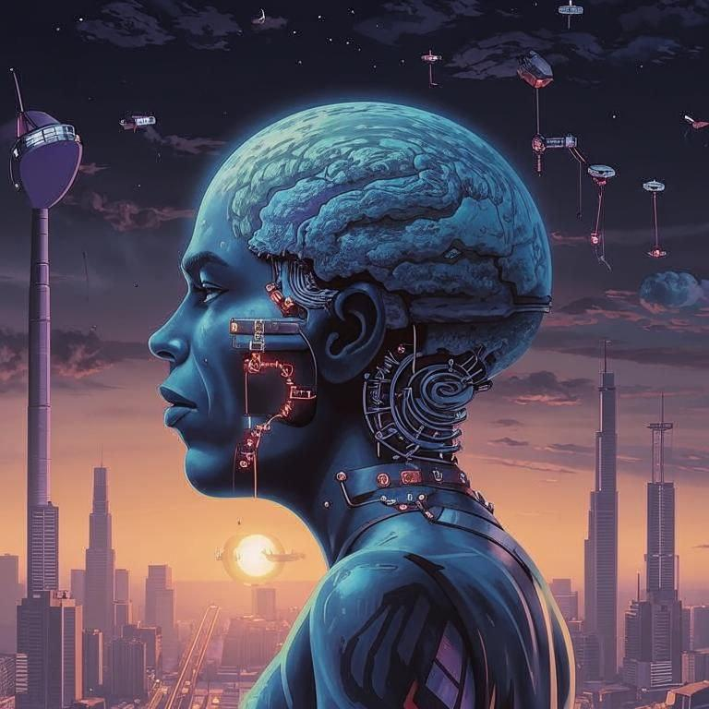
The main engine of society's development is human values
FAMILY
COMMUNICATION
HEALTH
SAFETY

Slide 7
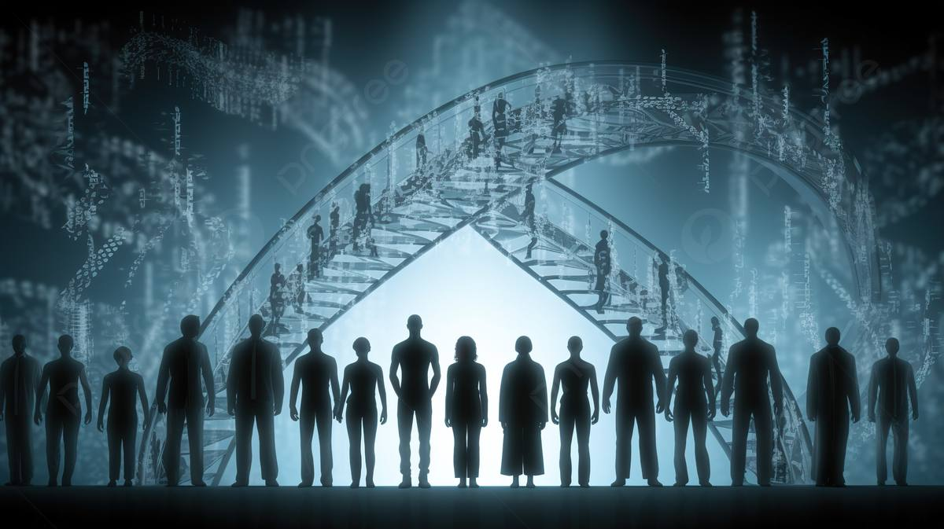
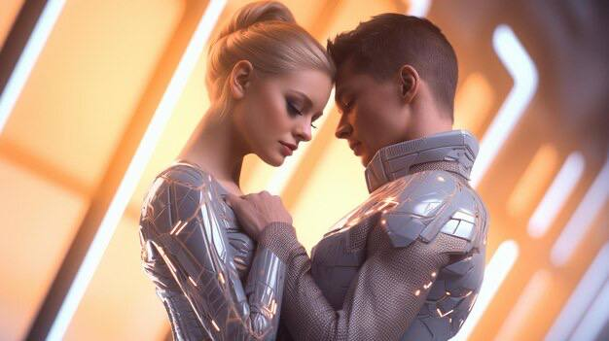
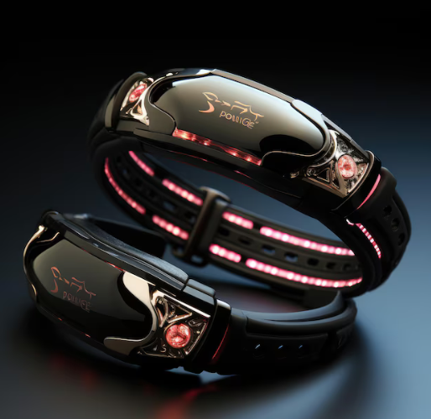
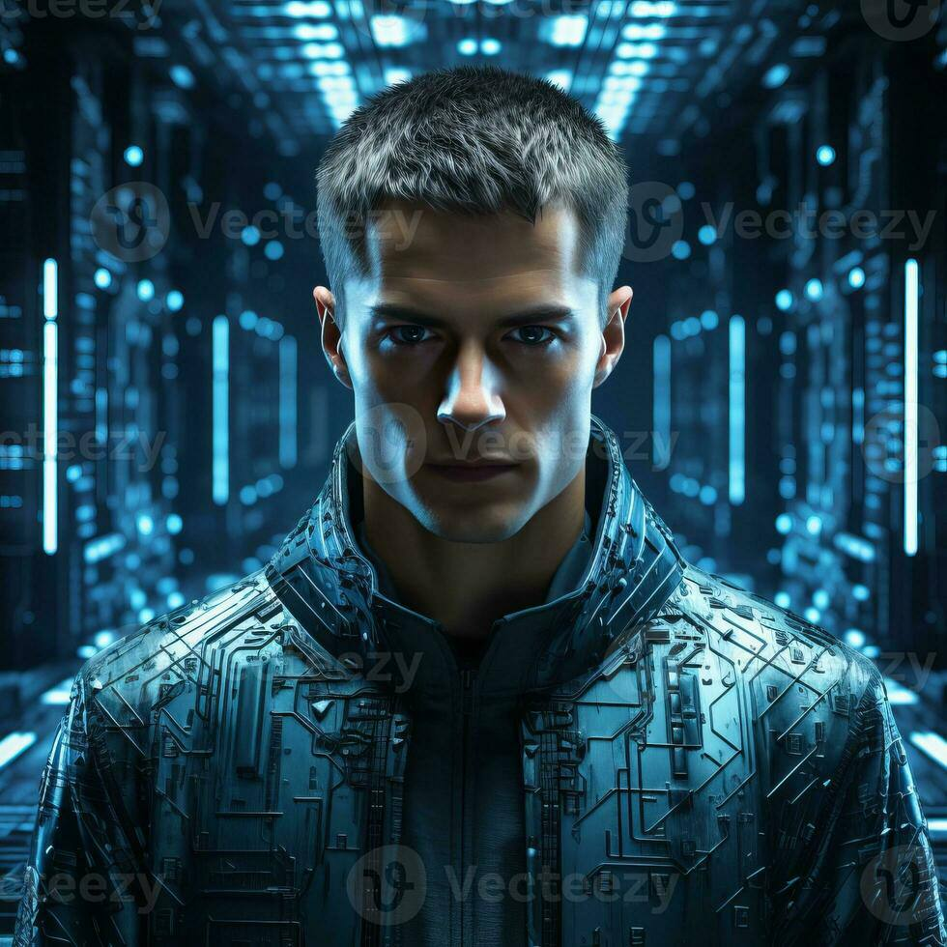
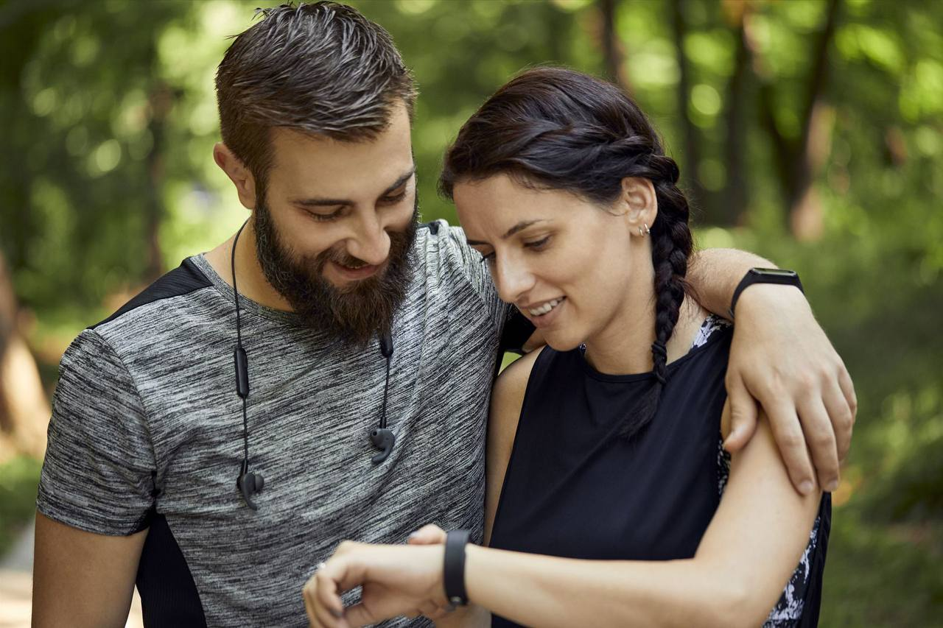
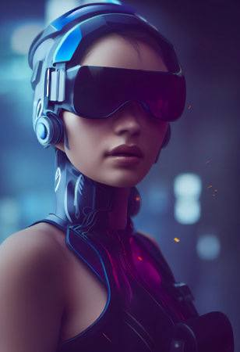

Slide 8
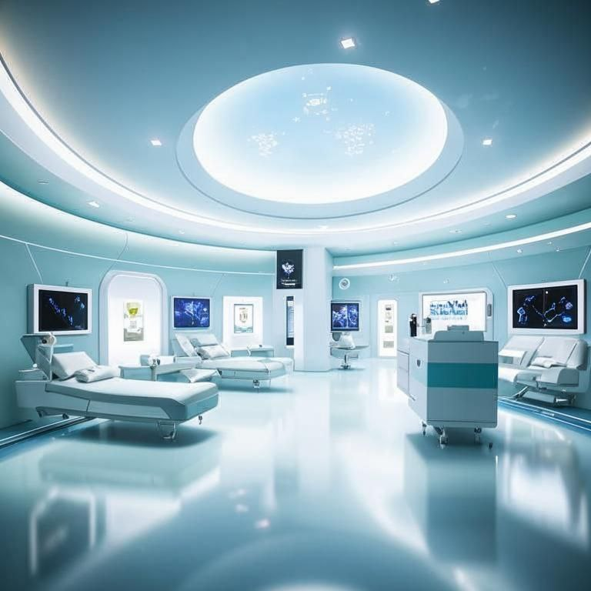
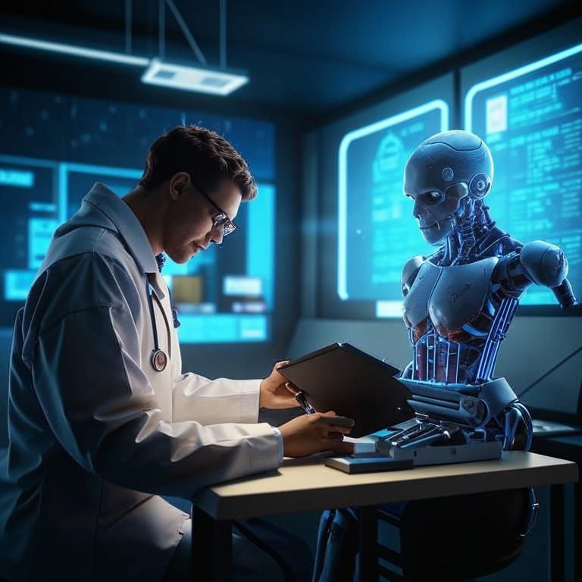
Individual medications for rapid recovery of health.
Artificial intelligence training based on the disease database.
Personalized treatment based on genetics and medical history.

Slide 9
THANK YOU FOR YOUR ATTENTION
The project is being implemented usingfunds from the Presidential Grants Fund
HORIZON 2100
Center for modeling the future

